Slide 2
MOBILE APP DEVELOPMENT
KARTHIKEYAN S

Slide 3
Company : Nasotech
Date of Joining : 08 / 01 / 2024

Slide 4
Mobile App Development
Flutter is a powerful open-source UI software development toolkit created by Google for building natively compiled applications for mobile, web, and desktop from a single codebase. With its expressive and flexible framework, Flutter simplifies the process of creating visually appealing and high-performance mobile applications.
Flutter's key feature is its ability to provide a consistent and visually rich user experience across multiple platforms, including Android and iOS. This is achieved through a widget-based architecture where everything is a widget, from structural elements like buttons and text to complex layouts. Developers can easily customize and compose widgets to create stunning interfaces that adhere to platform-specific design guidelines.
Dart, the programming language used with Flutter, is object-oriented and optimized for building modern, reactive applications. Dart's combination of a just-in-time (JIT) compiler during development and an ahead-of-time (AOT) compiler for production results in fast execution and efficient resource utilization.
Flutter also offers a rich set of pre-designed material and Cupertino widgets that seamlessly integrate with Android and iOS platforms, respectively. Additionally, developers can leverage a vast array of third-party packages from the Flutter community, further enhancing the toolkit's functionality and accelerating development.
In conclusion, Flutter empowers developers to create cross-platform mobile applications with a single codebase, reducing development time, improving consistency, and providing a delightful user experience. Its flexibility, hot reload feature, and extensive widget library make it an excellent choice for mobile app development in today's dynamic and competitive landscape.

Slide 5
Project Work Required Tools :
Figma
Flutter
Firebase
Dart Language
VS Code – IDE
Python Language
Docker

Slide 6





My Work in the project :
Figma
Flutter
Firebase
Data Creation
Data Flow

Slide 7
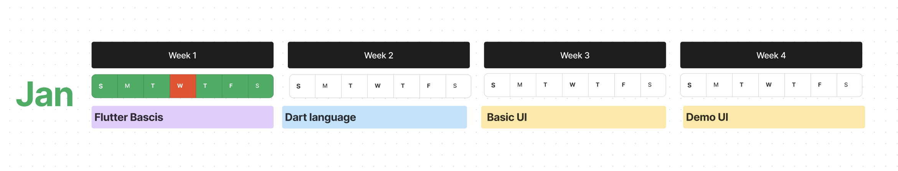
Figma Design 1

Slide 8
Requirements of the project app - Kavigai
1st Requirement – Goal Management
Change the begin & end date of services all at once using creative slider method
2nd Requirement – SmartGoal Management
Recommending services to user according to their goals

Slide 9
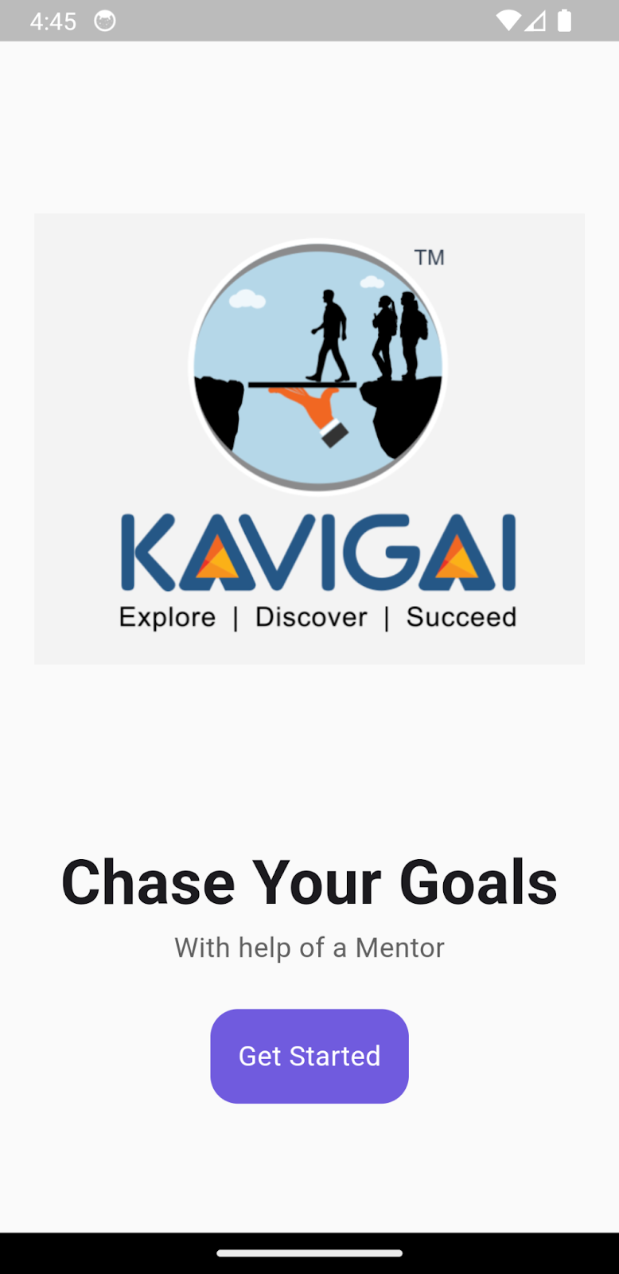
WELCOME PAGE
Flutter welcome page containing Kavigai Logo
Motive of kavigai
Get started button to connect with kavigai

Slide 10
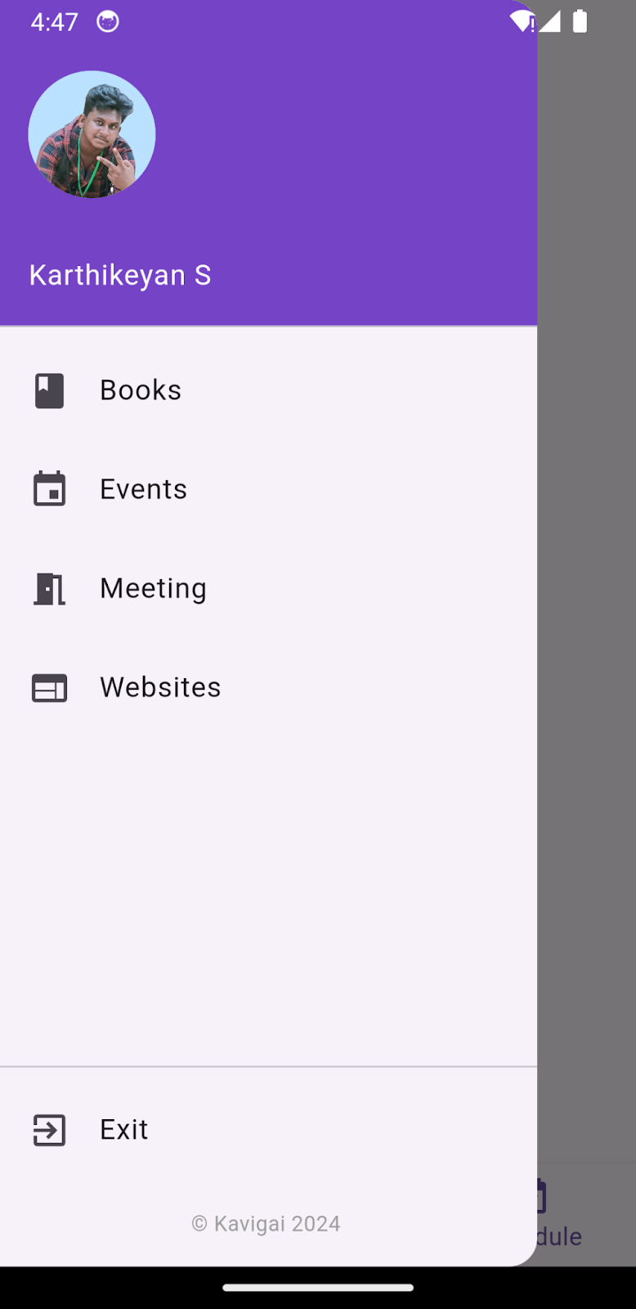
MENU DRAWER PAGE
Flutter Menudrawer page containing Account name and Profile Picture
Recommendation Contents like
Books, Events, Meeting, Websites
Log out Button

Slide 11
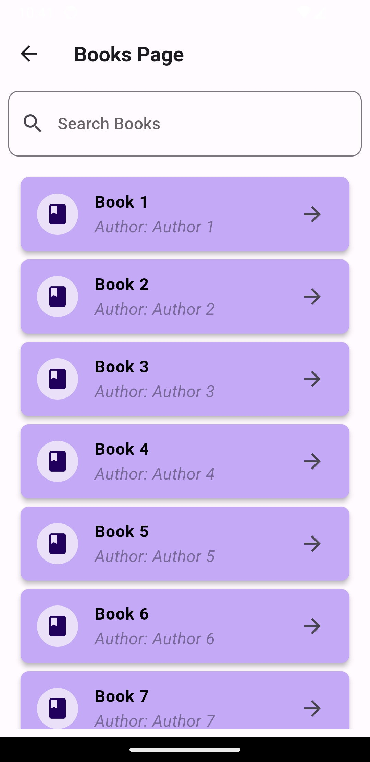
MENU DRAWER PAGE
Flutter Menudrawer page containing Account name and Profile Picture
Recommendation Contents like
Books, Events, Meeting, Websites
Log out Button

Slide 12
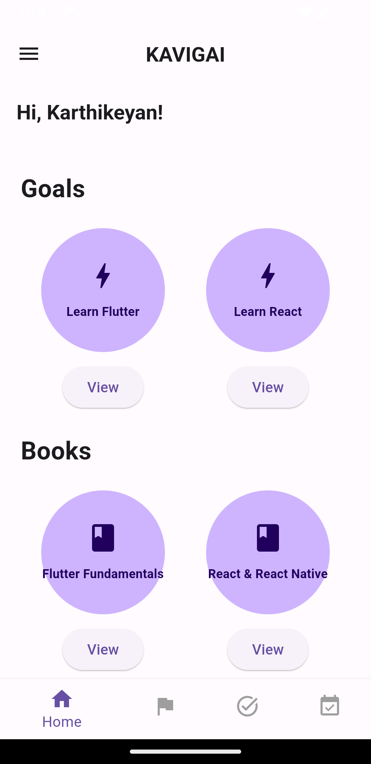
HOME PAGE
Flutter Home page containing Default Home page
Goal Page
Service Page
Schedule Page
Menudrawer Top left App Bar
Kavigai name on App Bar

Slide 13
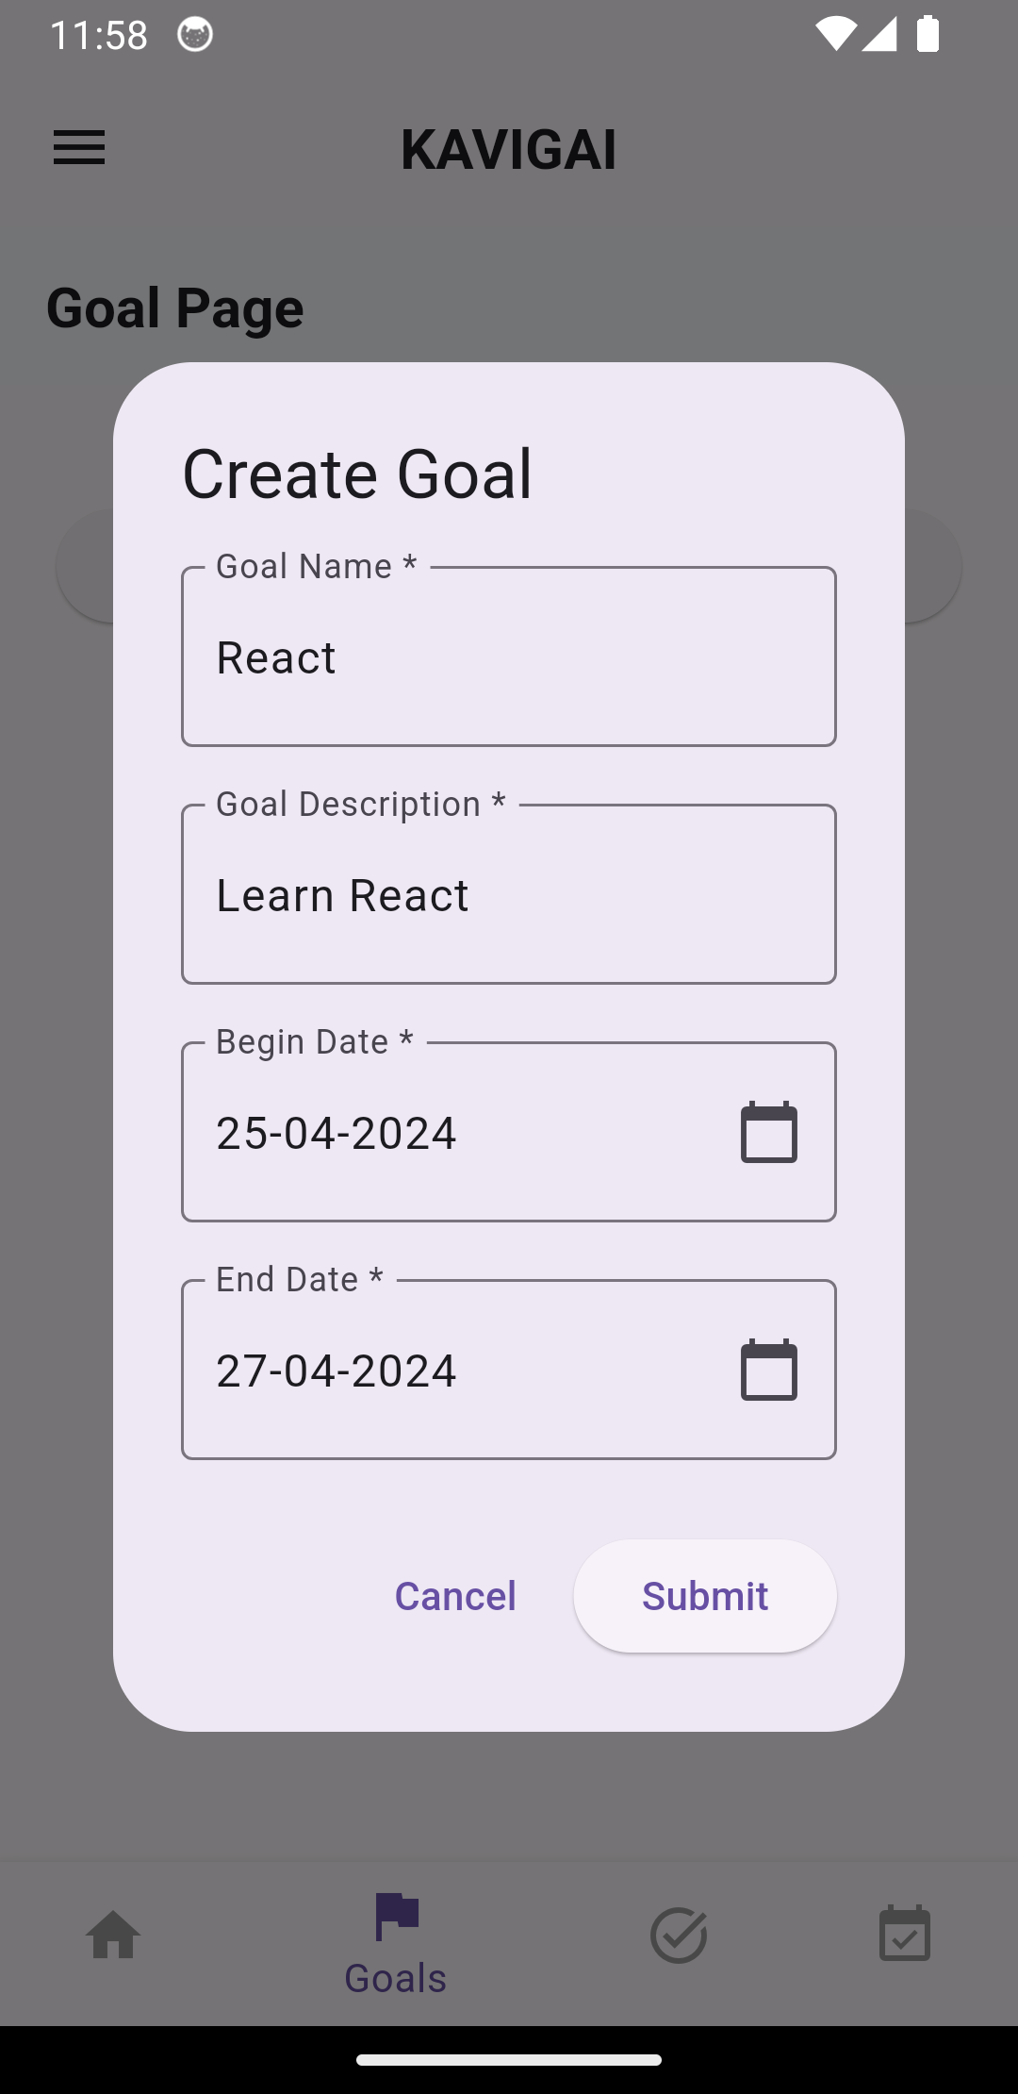
GOAL PAGE
Flutter Goal page containing creation goal
Goal name, description, begin date, end date
Submit and Cancel Button

Slide 14
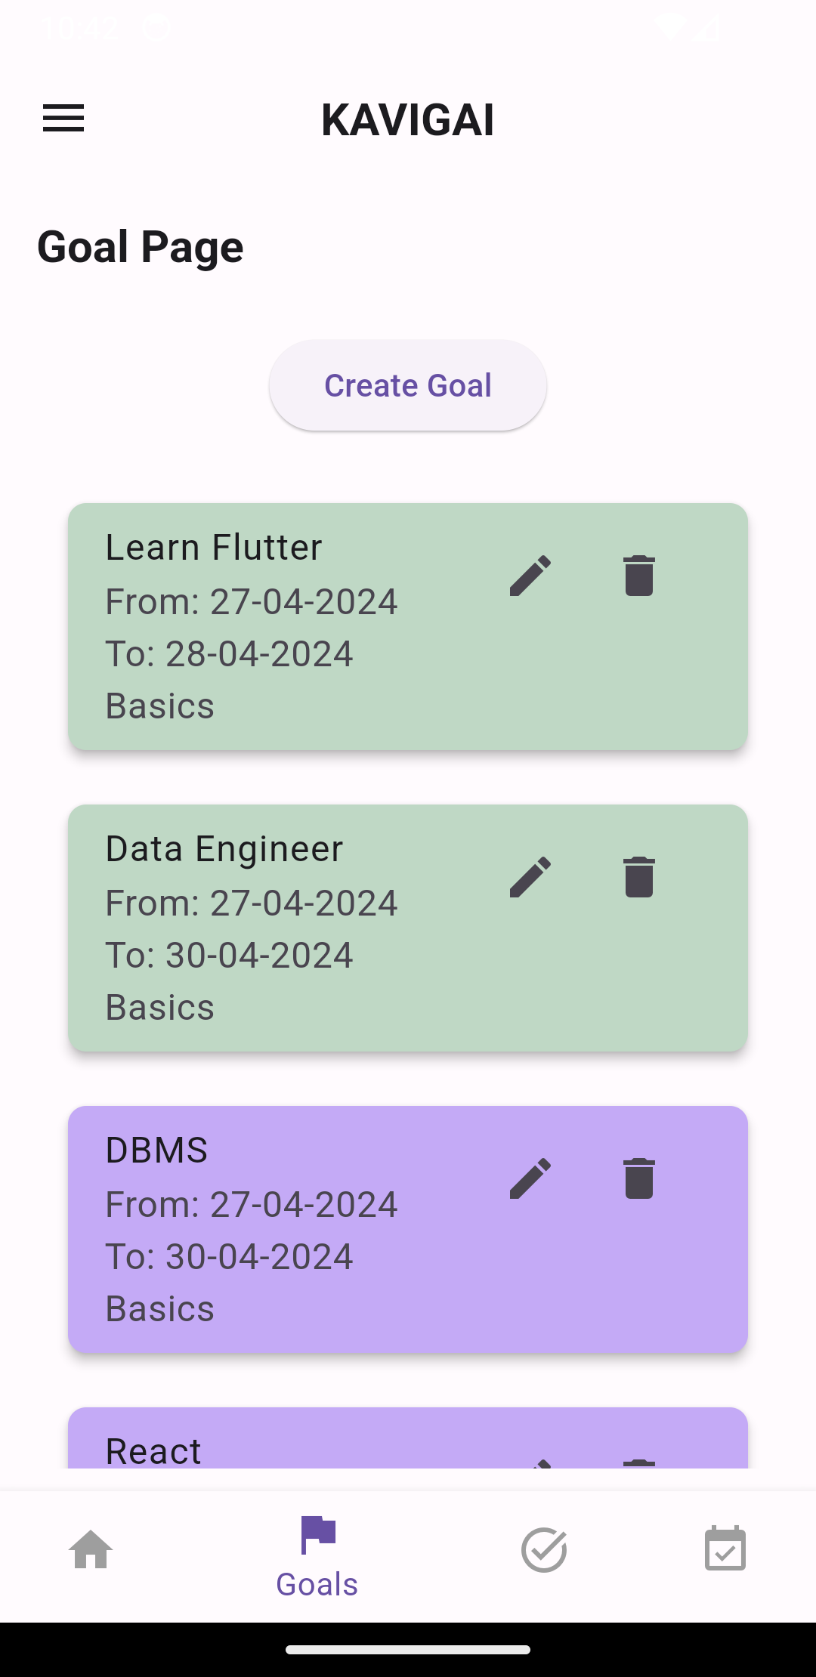
GOAL PAGE
Flutter Goal page containing creation goal
Goal name, description, begin date, end date
Submit and Cancel Button

Slide 15
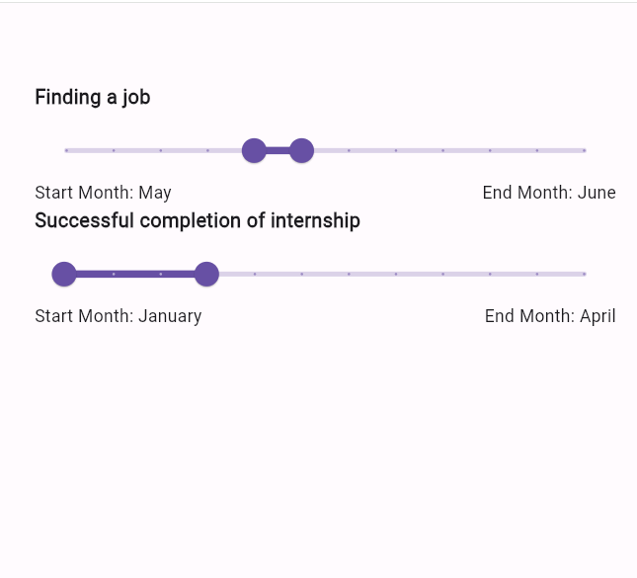
SERVICE PAGE
Flutter Goal page containing creation goal
Goal name, description, begin date, end date
Submit and Cancel Button

Slide 16
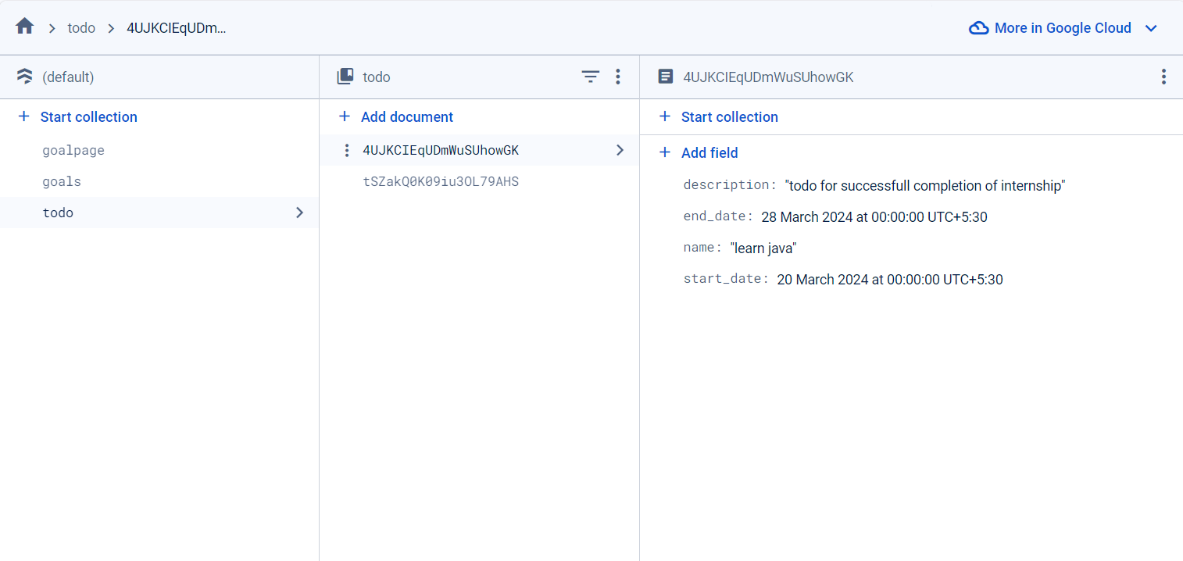
Firebase Connect :

Slide 17
Expected Outcomes & Work Done Percentage :
1st Requirement – Goal Management
Change the begin & end date of services all at once using creative slider method
2nd Requirement – SmartGoal Management
Recommending services to user according to their goals
Done
Done

Slide 18
THANK YOU

